Slide 1
Hybrid Cloud
A hybrid cloud is one in which applications are running in a combination of different environments. Hybrid cloud computing approaches are widespread because almost no one today relies entirely on the public cloud. Many of you have invested millions of dollars and thousands of hours into on-premises infrastructure over the past few decades. The most common hybrid cloud example is combining a public and private cloud environment, like an on-premises data center, and a public cloud computing environment, like Google Cloud.

Slide 2
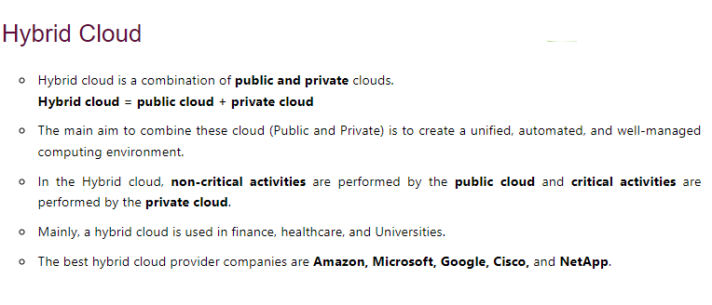
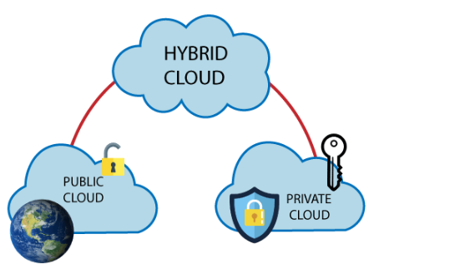

Slide 3
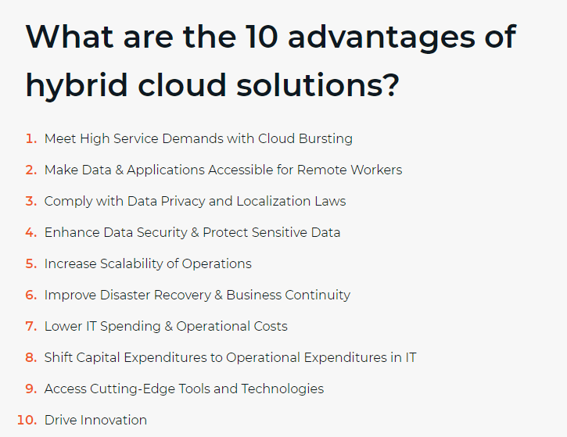

Slide 4
Challenges of Hybrid Cloud
The disadvantages of hybrid cloud pros and cons will always depend on the organization. Each organization should have a risk management and backup policy. This includes creating risk registers and deciding appropriate actions based on risks that the organization might experience. Listed are a few of the general cons and disadvantages associated with hybrid clouds, though mileage may vary depending on your organization
Disadvantages of hybrid clouds:
Increased complexity increases cost and the need for organizational expertise to manage public and private cloud environments, including vendors, platforms, and internal IT resources.
Capital expenses associated with on-premise environments.
With increased complexity also increases the risk of security attacks.
Disadvantages and cons are in the eye of the organization. Organizations should partner with external vendors to help with organizational assessments to determine challenges and then create actionable business plans and high-level roadmaps for success.

Slide 5
Hybrid Cloud Development
Implementing a successful hybrid cloud strategy requires involving all aspects of the business beyond the IT department to help determine current application issues and what benefits the cloud can bring to end users. These employees, from HR to marketing to CFO and beyond, hold important knowledge that can guide the hybrid cloud strategy over time. Security will always be paramount in a hybrid cloud strategy. End users can provide insights to your security team during application assessment to understand each app’s security and regulatory needs and how that translates to the hybrid cloud.
End users and IT bring a broad spectrum of expertise in how apps work and how they should work within the business. The challenge for IT is that few internal IT teams have the deep expertise across all cloud providers to determine which is best for the hybrid strategy needs.
Cloud managed services bring specific expertise that many teams lack, so having some support from a skilled partner in these areas can be paramount to success. Having access to fractional expert personnel support at different stages of the hybrid cloud strategy execution can relieve the burden on internal IT teams. That same consultative support can:
Provide a consultative approach to developing an effective hybrid cloud strategy
Make needed application and workload assessments
Provide needed fractional personnel and experts
Help train internal IT teams on how to test, manage, monitor, and expand the hybrid strategy over time so that knowledge transfer benefits the in-house IT teams.

Slide 6
Essentials for Hybrid Cloud Management
Following are a few essential considerations for successful hybrid cloud management.
Security and governance—with today’s DevSecOps mindset, you need to plan security for your hybrid cloud from the get go. Identify the security requirements of on-premise and cloud environments, and use tools like Identity and Access Management (IaM) to create homogenous security interfaces across environments. Monitor to ensure security requirements like encryption do not affect performance.
Workload inventory—understand which workloads are expected to run in the hybrid cloud, and how they leverage on-premise and public cloud resources. Map out applications and understand their value to users, expected loads, data requirements, integrations, networking, and anything else that can impact availability or performance.
Visibility across multiple cloud environments—relying on dashboards or interfaces for each separate cloud environment can quickly become messy. Use a tool or technology that can collect data from all on-premise and public cloud systems and display them on a single pane of glass. Seeing everything in one place, with a common system for metrics and reporting, will make management much easier.
Service level agreements (SLA)—hybrid clouds are very sensitive to performance, so SLAs are an essential part of planning. Construct public-private interfaces, data transfer pipelines and latencies so that you can comfortably meet user performance expectations. Use public and private cloud resources wisely to achieve high availability that can meet uptime requirements.

Slide 7
Key Capabilities of Hybrid Cloud Management Solutions
Hybrid cloud management is a discipline, but it is almost always practiced with specialized cloud management tools. Here the common capabilities offered by Hybrid Cloud Management (HCM) solutions.
Service aggregation—showing services and applications running on multiple cloud environments in one place and allowing you to manage them as a single unit.
Cost management—allowing you to set flexible policies for cost across cloud solutions and maximize your ROI, for example by moving data to the cheapest applicable storage option.
Self-service—allowing users to deploy, consume and terminate workloads without worrying about the underlying infrastructure.
Release and deployment orchestration—supporting DevOps and CI/CD workflows by letting developers automate deployment of dev, test and production environments.
Workload and cost analytics—providing rich, actionable data about what is running on the hybrid cloud and the costs incurred by cloud providers.
Integrations and APIs—making it easy to integrate the hybrid cloud with existing enterprise systems and development tools, both in the cloud and on-premises.
Platform as a Service (PaaS)—allowing users to consume databases and other common infrastructure elements as a managed service.
Workload migration—providing automated, fast and low-risk options for moving workloads from private to public cloud environment and back.

Slide 8
Hybrid Cloud Solutions: Key Considerations
When evaluating hybrid cloud solutions, enterprises should keep in mind certain technology and organizational considerations, including the following:
Organizational dynamics. Who are the various IT constituencies in the enterprise, and how are their current needs being met (or not) with the existing IT environment? The various IT stakeholders — IT buyers, decision makers, administrators, and end users (i.e., application developers and line-of-business managers) — may take different paths to cloud. Transformation-oriented IT leaders can leverage hybrid cloud to position themselves as enterprise IT architects who ensure that resources are centralized, stable, and secure but dynamically available to serve both IT operations and IT-driven business requirements.
Workload placement. Which applications are best suited for onsite private clouds, which can benefit most from operating in offsite public cloud environments, and which are ideally positioned to move between environments as needed based on load, scalability, cost optimization, application life-cycle, and end-user experience/proximity requirements? The decision-making process plays out across multiple vectors, encompassing the security, performance, and compliance requirements of individual application, workload, and business process components.

Slide 9
Hybrid Cloud Solutions: Key Considerations
Hybrid cloud use cases. What IT workloads will hybrid cloud be used to enable? The offsite dimension of hybrid cloud can support peak load resource bursting for production environments, scalable sandboxes for software testing and development, and disaster recovery/remote storage scenarios. Hybrid cloud can also support the broader objective of location-agnostic IT where workloads simply run in the appropriate environment — onsite or offsite, with business, application life-cycle, scale-up/scale-out requirements, and other factors determining what runs where.
Service provider selection. When making the decision about a hybrid cloud solution partner, organizations should consider whether the offering is fully integrated with enterprise IT or just loosely connected raw compute and storage capacity delivered to end users in the organization.

